Slide 1
R Language
VIT University
Chennai campus

Slide 2
Introduction
The R system for statistical computing is an environment for data analysis and graphics.
The root of R is the S language.
It is developed by John Chambers and colleagues at Bell Laboratories(1960).
Installation of R
R has a command line interface
R is a programming Language and Rstudio (IDE) is an interface for R

Slide 3
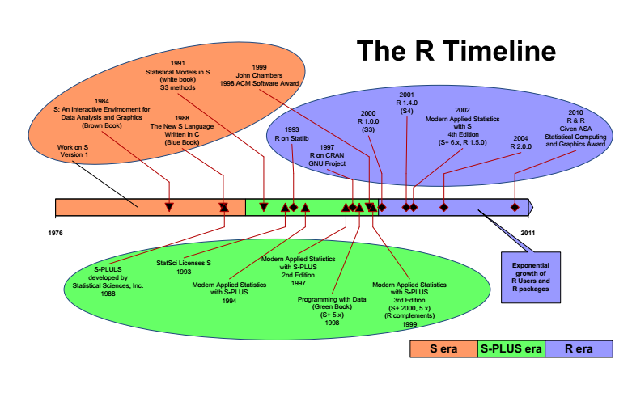
R Time Line

Slide 4
Introduction
The Strengths of R Tool:
R is a powerful tool for Data Manipulation.
R → Data Analysis
R → Statistical Modelling
R → Data Visualization
R is an interpreted language
An R interpreter must be running in order to evaluate R commands or execute R scripts
Rgui
RStudio

Slide 5
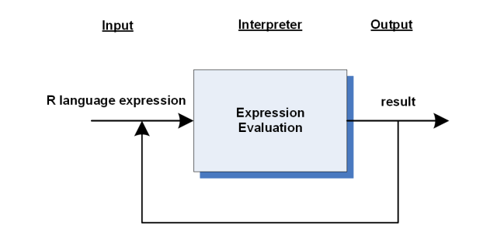
Introduction
R Expression Evaluation:
R Expressions are processed via R’s Read-Evaluate-Print-Loop → REPL

Slide 6
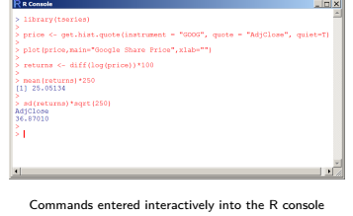
Introduction
RGui is an interactive command driven environment.
we can type R – Commands (including expressions) in R – Console.
We are able to copy and paste multiple commands in R – Console

Slide 7
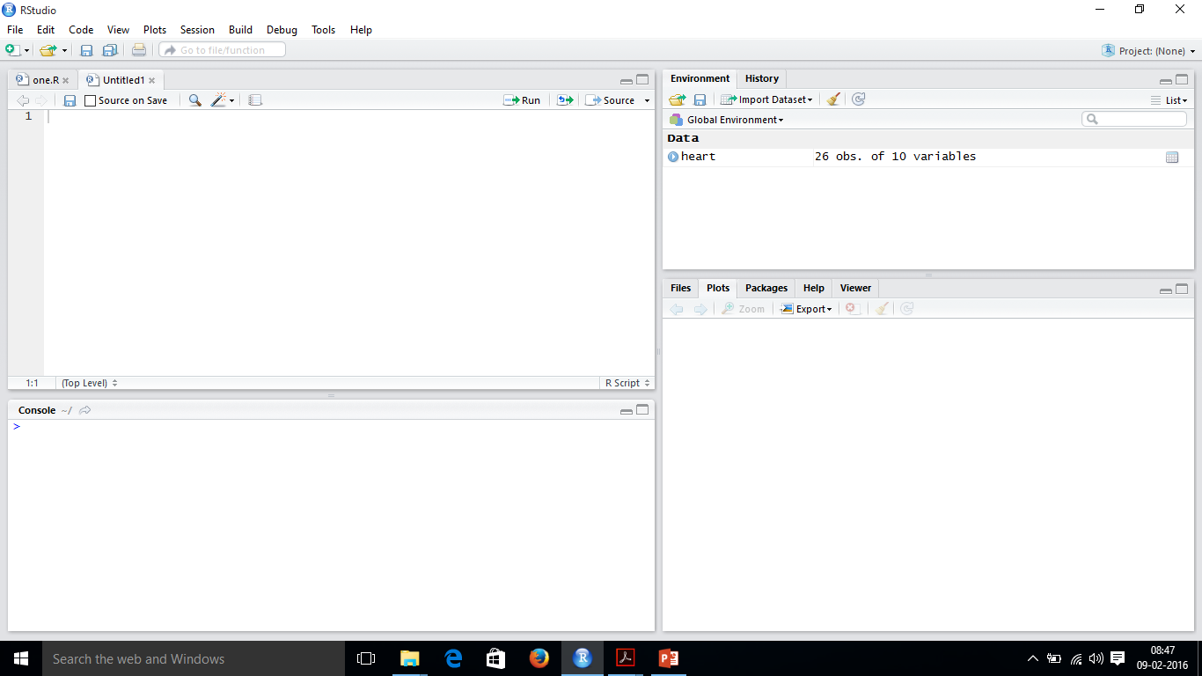
Rstudio Layout
Editor Window
History Window
Help window
Console Window

Slide 8
Rstudio Layout
Console window:
It is situated at Bottom Left of the RStudio Layout
It is also called command window
We can write commands
All commands can be executed in this window only

Slide 9
Rstudio Layout
Editor window:
It is situated at Top Left of corner of the RStudio Layout
We are using this window for writing scripts → collection of commands
It is also called script window
If this window is not visible, we can get it by File → New → Rscript
Click RUN or CRTL+ENTER to send the highlighted commands to command window

Slide 10
Rstudio Layout
History window:
It is situated at Top Right of corner of the RStudio Layout
In this window, we can see the data and values of R which are currently stored in memory.
It is also called workspace window
We can view and edit the values by clicking on them
This history window shows what has been typed so far

Slide 11
Rstudio Layout
Help window:
It is situated at the right bottom of RStudio Layout
Here we can open files and view plots
We can install and load the packages

Slide 12
Short-cut Keys in Rstudio
Shortcut Keys :
Easy running of the code: CTRL+ENTER (runs highlighted lines of code)
Even easier: CTRL+ENTER+P re-run the last-run code
<tab> works for auto completion
CTRL+1 → source editor
CTRL+2 → Console
CTRL+L → clear the console
CTRL+O → Open the file
CTRL+S → save the fie
CTRL+F → find
CTRL+shift+N → opens new document
ESC → interrupt a lengthy R command
CTRL+shift+C → comment or uncomment (highlighted code)

Slide 13
Help system in R : http://www.r-project.org
R has Comprehensive HTML help facility.
Give command → help.start() in R-Console window → We are able to see the R Language documentation in HTML pages
we able to open same with following URL:
http://127.0.0.1:28913/doc/html/index.html
Obtaining help on a particular topic:
help(topic)
?topic
Search help for a particular topic via help.search()
help.search()
??topic
Example:
>help(“data.frame”)
>?”vector”
Example:
>help.search(“predict”)
>??”predict”

Slide 14
Setting the Working Directory in RStudio
Setting the working directory:
To store working file.
create a folder and named as RdataWork.
To create working directory → setwd(“path”).
setwd(“E:/studies/VIT/R/RdataWork”) in windows environment
setwd(“~/RdataWork/”) in Linux environment

Slide 15
R as a Simple Calculator
R as a simple Calculator:
Typing in a mathematical expression and hitting enter prints out the result.
> 1 + 2
[1] 3
Order of operation rules worked as expected
Mathematical functions such as the square root →sqrt
> sqrt(36)
[1] 6

Slide 16
R as a Simple Calculator
R as a simple Calculator:
The result of mathematical expression can be assigned to an object in R. → <- Operator
var1 <- sqrt(81)
var1
Every object in R belongs to a class → type of the object it represents
class(var1)
[1] “numeric”
Everything in R is an object, including functions.
ls() → list objects → prints the all the objects.

Slide 17
R as a Simple Calculator
R as a simple Calculator:
5 %% 4 → Check the output
log(2) → Check the output
cos(pi) → Check the output
ceiling(3.2) → Check the output ;;; round(123.456,digits=2) → check output
0/0 → check the out put ;;; round(-123.456,digits=-2) → round numbers to multiples of 10, 100, etc
1/Inf → check the output ;;; signif(-123.456,digits=4) → number of significant digits to be retained
few maths functions are:
abs, sqrt, log, exp, log10, factorial
few Trig functions are:
sin, cos, tan, asin, acos, atan
Rounding functions are:
round, ceiling, floor, trunc, signif, zapsmall
math quantities are:
Inf, -Inf, NaN, pi, exp(1), 1i
$ floor(123.45) → check output
$ floor(-123.45) → Check output
floor(x) rounds to the nearest integer that’s smaller than x

Slide 18
Operation Symbols in R
Operation Symbols in R:
Symbol | Meaning
+ | Addition
- | Subtraction
* | Multiplication
/ | Division
%% | Modulo (estimates remainder in a division)
^ | Exponential

Slide 19
Numbers in R
Numbers in R:
NAN (not a number)
NA (missing value)
Basic handling of missing values
> var2 =c(1,2,3,4,5,6,NA)
> var2
[1] 1 2 3 4 5 6 NA
> mean(var2)
[1] NA
> mean(var2,na.rm=TRUE)
[1] 3.5

Slide 20
Variable assignment in R
Variable assignment in R:
> var10 = 25
[1] 25
Var11 <- 29
[1] 29

Slide 21
Variable assignment in R
Variable assignment in R:
> var10 = 25
>var10
[1] 25
>var11 <- 29 ;; typeof(var11) → check result
>var11
[1] 29
we can create a list using c-command
var22 <- c(1,2,3,4)
mean(var22) → check the output
var(var22) → check the output

Slide 22
Basic Data Types in R
Basic Data types in R:
Numeric
Integer
Complex
Logical
Character
Vector
Matrix
List
Data Frame

Slide 23
Basic Data Types in R
Numeric in R:
> var12 = 25.12
>var12 → check output
is.integer() → used to check whether a given variable object is integer or not
is.integer(var12) → check output
typeof(var12) → check output

Slide 24
Basic Data Types in R
Integer in R:
To create an integer variable in R → as.integer().
>var23 <- as.integer(999)
> var23 → check output
is.integer(var23) → check output
typeof(var23) → check output
class(var23) → check output
var34 <- as.integer(10.28)
var34 → check output
is.integer(var34) → check output
typeof(var34) → check output

Slide 25
Basic Data Types in R
Logical values in R: (and (&), or (|) , Negation(!)
True → 1 and False → 0
> as.integer(TRUE)
> 1
> as.integer(FALSE)
0
>x = 1
>y = 2
>z = x > y
>z → check the output
class(z) → check the output

Slide 26
Basic Data Types in R
complex values in R:
A complex value in R is defined via the pure imaginary value i.
> z = 1 + 2i
> z
[1] 1+2i
class(z) → check output
sqrt(-1) → check output
sqrt(as.complex(-1)) → check the output

Slide 27
Basic Data Types in R
Vector in R:
A vector is a sequence of data elements of the same basic type.
components → members in a vector
Examples
>c(10,20,40) → 3 members/ components
> [1] 10 20 40
>c(TRUE, FALSE, TRUE) → check output
>c(“VIT”, “Chennai”, “Campus”) → check output
>c(“VIT”, 600126) → check output
> class(c(600123,"vit")) → check output
>length(c(600123,"vit")) → check Output

Slide 28
Basic Data Types in R
Combining Vector in R:
>var25 = c(1,4,7)
>var26 = c("vit", "university")
>var27 = c(var25, var26)
>var27
class(var27) → check output
class(var26) → check output
class(var25) → check output

Slide 29
Basic Data Types in R
Combining Vector in R:
A vector is an ordered collection of objects of the same type
The function c(...) concatenates its arguments to form a vector
To create a patterned vector
: → Sequence of integers
seq() → General Sequence
rep() → Vector of replicated elements
$ rr ← - 3 : 3
$ rr → check output
$ seq(0,2,by=0.5) → check output
$ seq(0,2,len=6)
$ rep(1:5, each=2)
$ rep(1:5, times=2)

Slide 30
Basic Data Types in R
Vector arithmetic in R:
> var28 = c(2, 4, 6, 8)
> var29 = c(2, 4, 6, 8)
> var28 * var29
> var28 + var29
What’s happens if one vector size less compared to other vector → Recycling rule
> var30 = c(2,4)
> var28 + var30 → check the result
What happens if one vector is numeric and other is character → able to perform arithmetic operation these two vectors → No. why
y <- c(4,2,0,9,5,3,10)
sort(y)
sort(y, decreasing = TRUE)

Slide 31
Basic Data Types in R
Vector index in R:
> var33 = c (“vit”, “chennai”, “vellore”, “campus”)
> var33[1] → Check the output
We can retrieve the values in a vector, using indices, that has to used in array bracket. Index is starting from 1.
The result of the slice is also a vector.
Negative Index:
If the index is negative, it would strip the member whose position has the same absolute value as the negative index.
>var33[-2] → it skip the values at 2nd position in vector
Out of Range index:
If an index is out-of-range, a missing value will be reported via the symbol NA.
> var33[10] → check the output

Slide 32
Basic Data Types in R
Numeric index Vector in R:
A new vector can be sliced from a given vector with a numeric index vector, which consists of member positions of the original vector to be retrieved.
> var33[c(3,4)] → check output
Duplicate Indexes:
> var33[c(3,4,4)]
Out of Order Indexes:
>var33[c(4,3,1)]
Range – Index
> var33[1:3]
$ var28 <- c(4,7,2,10,1,0)
$ var28[ var28 > 3] → check output

Slide 33
Basic Data Types in R
which() and match() in R:
Additional functions that will return the indices of a vector
which() → Indices of a logical vector where the condition is TRUE
which.max() → Location of the (first) maximum element of a numeric vector
which.min() → Location of the (first) minimum element of a numeric vector
match() → First position of an element in a vector
var28 <- c(4,7,2,10,1,0)
var28 >= 4 → check the output
which(var28 >= 4) → check the output
which.max(var28) → check the output
var28[which.max(var28)] → check output
max(var28)
$ var40 <- rep(1:5, times = 5:1)
$ var40 → check output
$ match(1:5, var40)
$ match(unique(var40), var40)

Slide 34
Basic Data Types in R
Named Vector in R:
We can assign names to vector members
>var33
> names(var33) = c(“one”, “two”, “three”, “four”)
>var33 → check the output.
>var33[“two”] → check the output

Slide 36
Basic Data Types in R
Matrix in R:
A matrix is a collection of data elements arranged in a two-dimensional rectangular layout.
A matrix is just a two-dimensional generalization of a vector
To create a Matrix:
matrix(data = NA, nrow=1, ncol=1, byrow=FALSE, dimnames=NULL)
data → a vector that gives data to fill the matrix;
→ if data does not have enough elements to fill the matrix, then the elements are recycled.
nrow → desired number of rows;; ncol → desired number of columns
byrow → if false( default) matrix is filled by columns, otherwise rowwize
dimnames → (optional) list of length 2 giving the row and column names respectively, list
names will be used as names for the dimensions

Slide 37
Basic Data Types in R
Matrix in R:
Example:
> A = matrix(c(2,4,1,3,5,7),nrow=2,ncol=3,byrow=TRUE)
> A → check the output
> A[2,3] → check the output
> A[2, ] → check the output
> A[, 3] → check the output
> A[, c(1,3)] → check the output
> dimnames(A) = list( c(“r1” ,”r2”), c(“c1”,”c2”,”c3”) )
> A → check output
$ A <- matrix(1:4, nrow=2)
$ B <- matrix(1, nrow=2, ncol=2)
$ A → check output
$ B → check output
$ A * B → check output
$ A %*% B → check output
$ y <- 1:3
$ y → check output
$ y %*% y → check output

Slide 38
Basic Data Types in R
Matrix in R:
Example:
> K <- t(A) → check output → transpose of A
> B = matrix( c(10,20,30), nrow=3, ncol = 1)
> cbind(K,B) → check output → cbind() used for combining matrices by columns
> rbind() → use to combine matrices based on row-wise
c(B) → destruction the matrix →form a vector

Slide 40
Basic Data Types in R
apply() in R:
The apply() function is used for applying functions to the margins of a matrix, array, or dataframes.
apply(matrix, margin, fun(), …)
matrix → A matrix or array or a dataframe
margin → Vector of subscripts indicating which margins to apply the function to 1 = rows , 2 = columns, c(1,2) = rows and columns
fun() → function to be applied
x <- matrix(1:12, nrow=3, ncol=4) → check output
apply(x, 1, sum) → row totals → check output
apply(x,2, mean) → column means → check output

Slide 41
Basic Data Types in R
Lists in R:
A list is a generic vector containing other objects.
Example:
> n = c(2, 3, 5)
> s = c("aa", "bb", "cc", "dd", "ee")
> b = c(TRUE, FALSE, TRUE, FALSE, FALSE)
> x = list(n, s, b, 3)
x → check the output
x[2] → check the output
x[c(2,4)] → check the output

Slide 42
Basic Data Types in R
Lists in R:
Member Reference:
Example:
> x[ [2] ] → check the output
> x[ [2]] = “ra”
> x[ [2]] → check the output
> s → check the output

Slide 43
Basic Data Types in R
Lists in R:
Named List Member:
We can assign names to list members, and reference them by names instead of numeric indexes.
> v = list(bob=c(2, 3, 5), john=c("aa", "bb"))
> v → check the output
> v[“bob”]
> v[c(“bob”, “john”)]
> v[["bob"]] → check the output
> v$bob → check the output

Slide 44
Basic Data Types in R
attach() and detach() in R:
We can attach a list to the R search path and access its members without explicitly mentioning the list.
It should to be detached for clean up.
example:
> attach(v)
> bob → check output
detach(v)

Slide 45
Basic Data Types in R
Data frame in R:
A data frame is used for storing data tables.
It is a list of vectors of equal length.
Example:
> n = c(2, 3, 5)
> s = c("aa", "bb", "cc")
> b = c(TRUE, FALSE, TRUE)
> df = data.frame(n, s, b) # df is a data frame

Slide 46
Basic Data Types in R
Data frame in R:
Build – in Data Frames:
Example: → > mtcars
> mtcars → check the output
Header, data row or instances, cell or variable
mtcars[1,2] → give the cell value of first row and 2nd column.
> mtcars["Mazda RX4", "cyl"] → check output
> nrow(mtcars) → check output
> ncol(mtcars) → check the output
> help(“mtcars”)
> head(mtcars) → check output
> tail(mtcars) → check output
>dim(mtcars) → check output

Slide 47
Basic Data Types in R
Data frame column vector in R:
uses [[]] → data frame column
Example:
>mtcars[[6]]
> mtcars[[“am”]]
>mtcars$am
> mtcars[, “am”]

Slide 48
Basic Data Types in R
Data frame column slice in R:
>mtcars[1]
> mtcars[“mpg”]
> mtcars[c(“mpg”, “hp”]

Slide 49
Basic Data Types in R
Data frame Row slice in R:
Example:
>mtcars[24,]
> mtcars[c(3,24)] → to retrieve more than one row data

Slide 50
Data Import in R
Data import in R:
Code – 1:
> library(XLConnect)
> wk = loadWorkbook("mydata.xls")
> df = readWorksheet(wk, sheet="Sheet1")

Slide 51
Data Import in R
Data import in R:
Import of xls sheets
Code – 3 :
> library(xlsx)
> mydata <- read.xlsx("c:/myexcel.xlsx", 1)
> mydata <- read.xlsx("c:/myexcel.xlsx", sheetName = "mysheet")

Slide 52
Data Import in R
Data import in R:
Import of table file:
Code -1:
> mydata = read.table(“~~path/mydata.txt")
> mydata
Code – 2:
> mydata = read.table(file.choose(),header=TRUE/FALSE)
> mydata
>help(read.table) → see the output

Slide 53
Data Import in R
Data import in R:
Import of CSV file:
Code -1:
> mydata = read.table(“~~path/mydata.csv")
> mydata
Code – 2:
> mydata = read.table(file.choose(),header=TRUE/FALSE, sep=“,” , row.names=“id”)
> mydata

